Slide 1
ATOMIC ENERGY EDUCATION SOCIETY
Distant Learning Programme
Class XI Subject: Physics
Chapter: Unit and Measurement (Module 4/4)
Contents :
Dimension and its definition & dimensionless quantities.
Some important dimensional formulas.
Checking the Dimensional Consistency of Equations.
Deducing Relation among the Physical Quantities.
To convert any physical quantity from one unit system to another system.
Limitations of Dimensional Analysis.

Slide 2
Dimensions: An Introduction
Dimension: The dimensions of a physical quantity are the powers to which the fundamental quantities are raised to represent that physical quantity. They are represented by square brackets around the quantity.
The expression which shows how and which of the base quantities represent the dimensions of a physical quantity is called the dimensional formula of the given physical quantity.
An equation obtained by equating a physical quantity with its dimensional formula is called the dimensional equation of the physical quantity.

Slide 3
Dimensions of the 7 base quantities are – Length [L], Mass [M], time [T], electric current [A], thermodynamic temperature [K], luminous intensity [cd] and amount of substance [mol].
Let any physical quantity A ,depends mass, length ,time with powers a,b,& c then :
Dimensional Formula : [MªL^{b}T^{c}]
Dimensional equation : [A]= [MªL^{b}T^{c}]
For example, the dimensional equations of volume [V], speed [v], force [F ] and mass density [ρ] may be expressed as:
[V] = [M0 L3 T0]
[v] = [M0 L T–1]
[F] = [M L T–2]
[ρ] = [M L–3 T0]

Slide 4
Dimensionless Quantities:
The arguments of special functions, such as the trigonometric, logarithmic and exponential functions are dimensionless.
A pure number is always dimensionless.
ratio of similar physical quantities, such as angle as the ratio (length/length), refractive index as the ratio (speed of light in vacuum/speed of light in medium) etc., has no dimensions.
Plane angle and solid angles are dimensionless.
Dimensionless Constants: Such constants which do not have dimensions are called as dimensionless constants.
For ex. Refractive Index , relative density, velocity of light in vacuum etc.
Dimensional constants: Such constants which have dimensions are called as dimensional constants.
For ex. Universal gravitational constant, electric permittivity, Coefficient of elasticity etc.

Slide 5
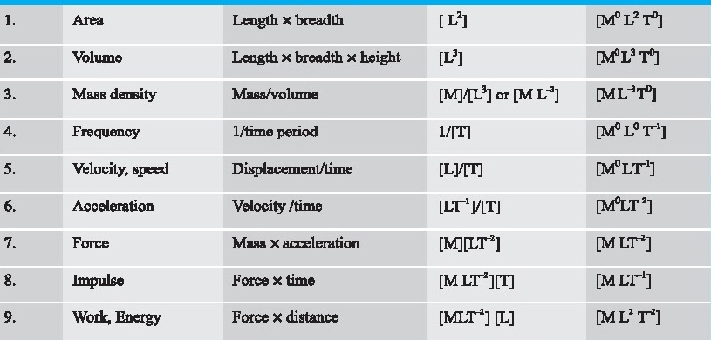
Some Important Dimensions for detail Refer to appendix A9 of NCERT Text book part 1

Slide 6
Applications of Dimensional Analysis

Slide 7
Checking the Dimensional
Consistency of Equations
Only those physical quantities which have same dimensions can be added and subtracted. This is called principle of homogeneity of dimensions.
According to this principle of homogeneity a physical equation will be dimensionally correct if the dimensions of all the terms occurring on both sides of the equation are the same.

Slide 8

Checking the Dimensional
Consistency of Equations
Example: Let us consider an equation
where m is the mass of the body, v its velocity, g is the acceleration due to gravity and h is the height. Check whether this equation is dimensionally correct.
The dimensions of LHS are:
[M] [L T^{–1} ]² = [M] [ L² T^{–2}] = [M L² T^{–2}]
The dimensions of RHS are:
[M][L T^{–2}] [L] = [M][L² T^{–2}] = [M L² T^{–2}]
The dimensions of LHS and RHS are the same and Hence the equation is dimensionally correct.

Slide 9
Deducing Relation among the
Physical Quantities
To deduce relation among physical quantities, we should know the dependence of one quantity over others (or independent variables) and consider it as product type of dependence.
• Dimensionless constants cannot be obtained using this method.

Slide 10
The dependence of time period T on the quantities l, g and m as a product may be written as:
T = k l^{x} g^{y} m^{z}
where k is dimensionless constant and x, y and z are the exponents. By considering dimensions on both sides, we have
[LºMºT¹]= [L]^{x}[L¹ T^{–2} ]^{y} [M¹ ]^{z}
= L^{x+y} T^{–2y} M^{z}
On equating the dimensions on both sides, we have
x + y = 0; –2y = 1; and z = 0 So that
x=1/2 y =-1/2 z=0
Then, T = k l^{½} g^{–½}
T=k√l/g
Deducing Relation among the Physical Quantities:
Example: Consider a simple pendulum, having a bob attached to a string, that oscillates under the action of the force of gravity. Suppose that the period of oscillation of the simple pendulum depends on its length (l), mass of the bob (m) and acceleration due to gravity (g). Derive the expression for its time period using method of dimensions.

Slide 11
To convert any physical quantity from one unit system to another system
If we want to convert a physical quantity from one unit system to another system, we can easily do that with the help of dimensional analysis.
A physical quantity has two parts; one is the numerical or magnitude part and the other part is the unit part. Suppose there’s a physical quantity X, which has unit “U” and magnitude “N”, then its magnitude is inversely proportional to unit system it will be expressed as:
X = NU
To convert a physical quantity from one unit to another we use below relation:
N₁U₁ = N₂U₂ ……………….(1)
Where N₁ and N₂ are numerical parts and U₁ and U₂ are dimensions or units of both quantities.
U₁ = [Mª₁ L^{b}₁ T^{c}₁] U₂ = [Mª₂ L^{b}₂ T^{c}₂] …….……….(2)
Using (1) & (2)
N₁ [Mª₁ L^{b}₁ T^{c}₁] = N₂[Mª₂ L^{b}₂ T^{c}₂]
If N₁ is known then magnitude N₂ can be calculated using this relation

Slide 12
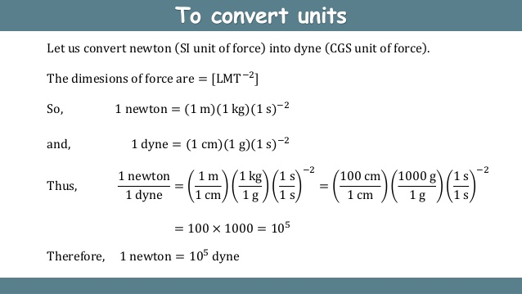

Slide 13
Limitations of Dimensional Analysis
Dimensional analysis has no information on dimensionless constants.
If a quantity is dependent on trigonometric or exponential functions, this method cannot be used.
In some cases, it is difficult to guess the factors while deriving the relation connecting two or more physical quantities.
This method cannot be used in an equation containing two or more variables with same dimensions.
It cannot be used if the physical quantity is dependent on more than three unknown variables.
This method cannot be used if the physical quantity contains more than one term, say sum or difference of two terms.

Slide 14
References :
NCERT XI class
Wikipedia Concept of physics by H C Verma
By: Govind Sharma
PGT (Physics)
AECS 4, Rawatbhata

